Slide 1


Global AI Workforce and Hiring Trends Analysis 2020-2026
A
F
0
5
1
0
0
6
9
2

Slide 2
Introduction
Artificial Intelligence has become a key driver of technological innovation, leading to a significant increase in demand for AI professionals across industries. Organizations increasingly rely on AI professionals such as Data Scientists, Machine Learning Engineers, and AI Engineers.
Understanding hiring trends, salary patterns, work culture, and job security is important for companies and professionals This project analyzes global AI workforce and hiring trends from 2020 to 2026 using Power BI dashboards.

Slide 3
Objectives
Analyze global AI hiring trends across different countries.
Examine salary distribution based on country and experience level.
Identify the most demanded AI job roles and specializations.
Understand workforce experience including work-life balance and employee satisfaction.
Study hiring challenges such as automation risk and layoff risk.

Slide 4
Dataset Overview
Dataset is from Kaggle with 90K records of Global AI Workforce
The dataset was very rich with more information contains information about global AI workforce
Trends
For now these are the area that was essential to have quick glance of AI workforce globally
Country
Job Role
AI Specialization
Salary
Experience Level
Industry
Work Mode
Job Openings
Employee Satisfaction
Hiring Difficulty Score etc

Slide 5
Dashboard Design
Dashboard 1 – Global Hiring Overview Shows the growth of AI job opportunities across countries and years.
Dashboard 2 – Salary Analysis Visualizes salary distribution based on country and experience level.
Dashboard 3 – AI Roles & Skills Demand Highlights the most demanded AI job roles and specializations.
Dashboard 4 – Workforce Experience Analyzes employee satisfaction, work-life balance, and work mode.
Dashboard 5 – Hiring Challenges Shows hiring difficulty, automation risk, and job security trends.

Slide 6
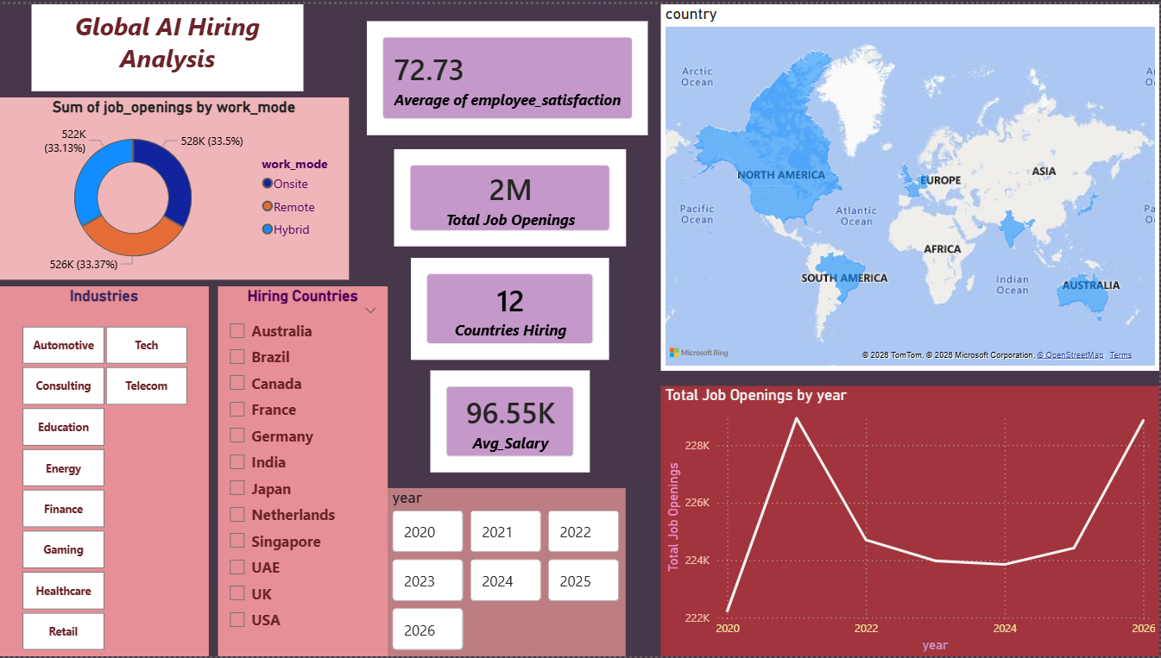

Slide 7
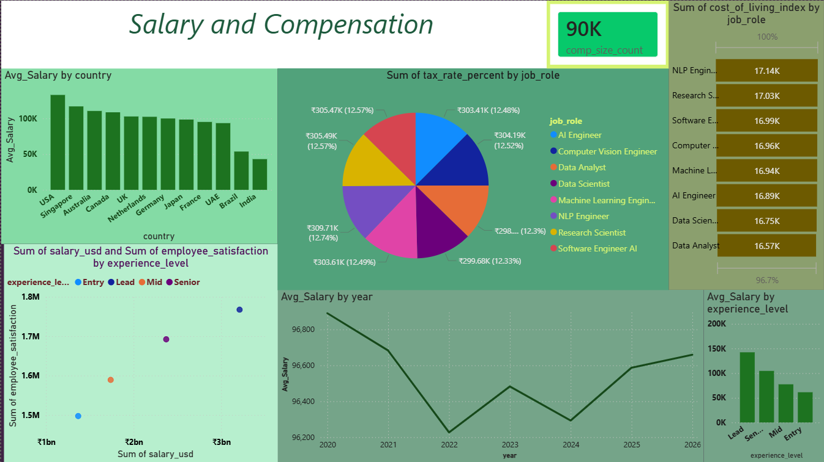

Slide 8
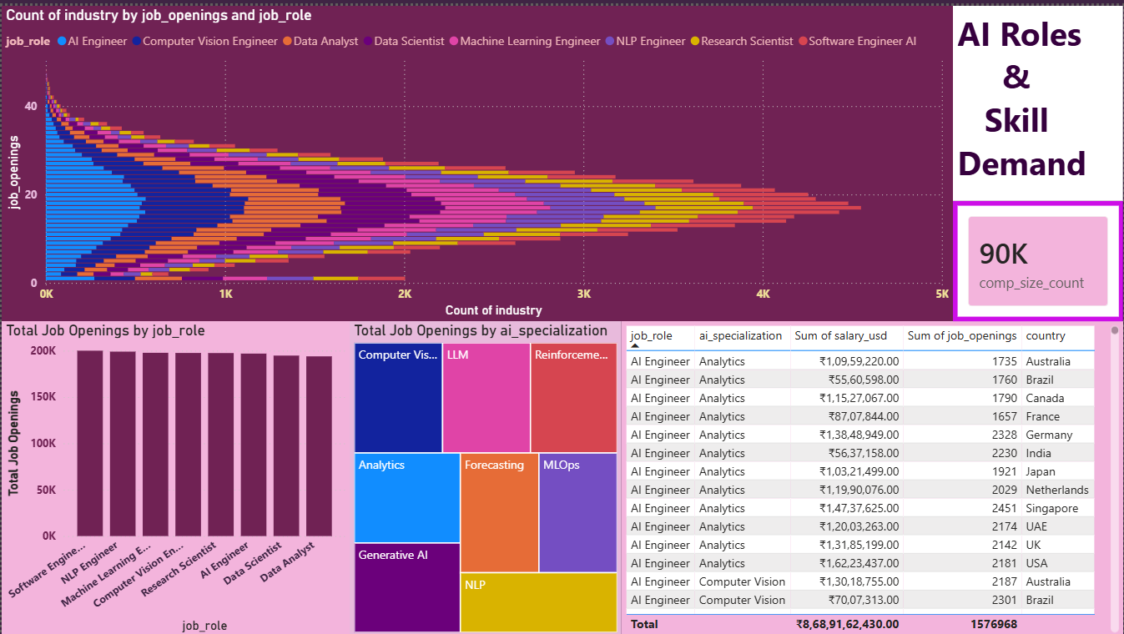

Slide 9
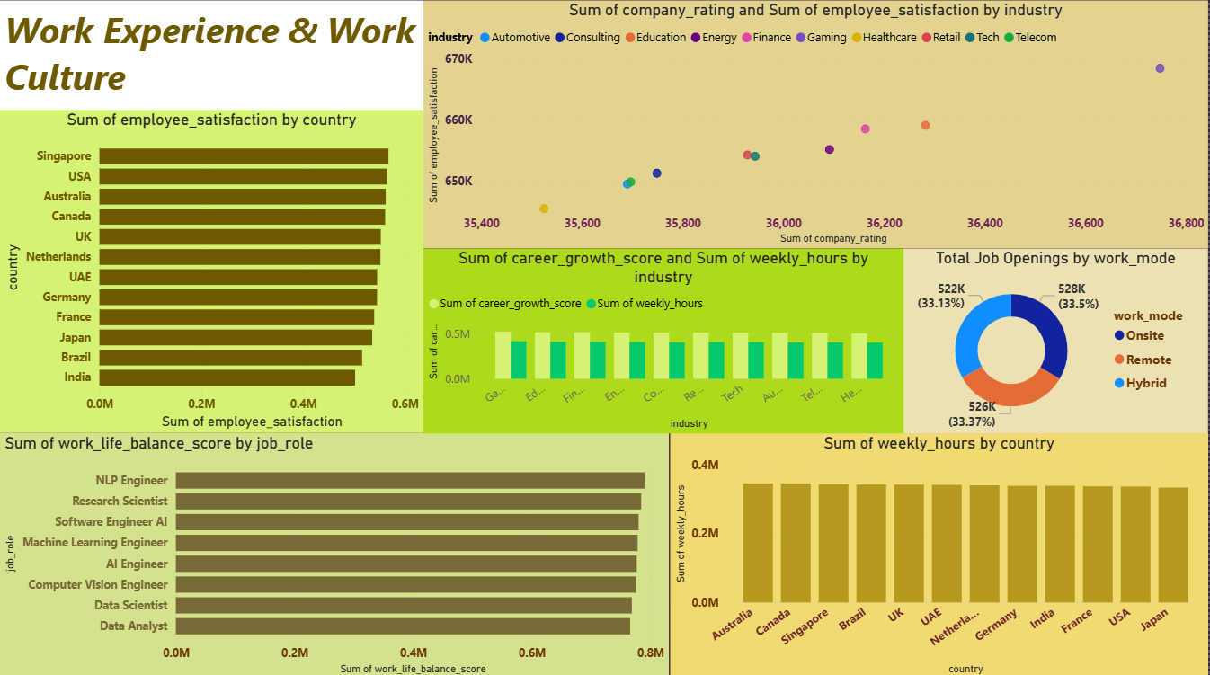

Slide 10
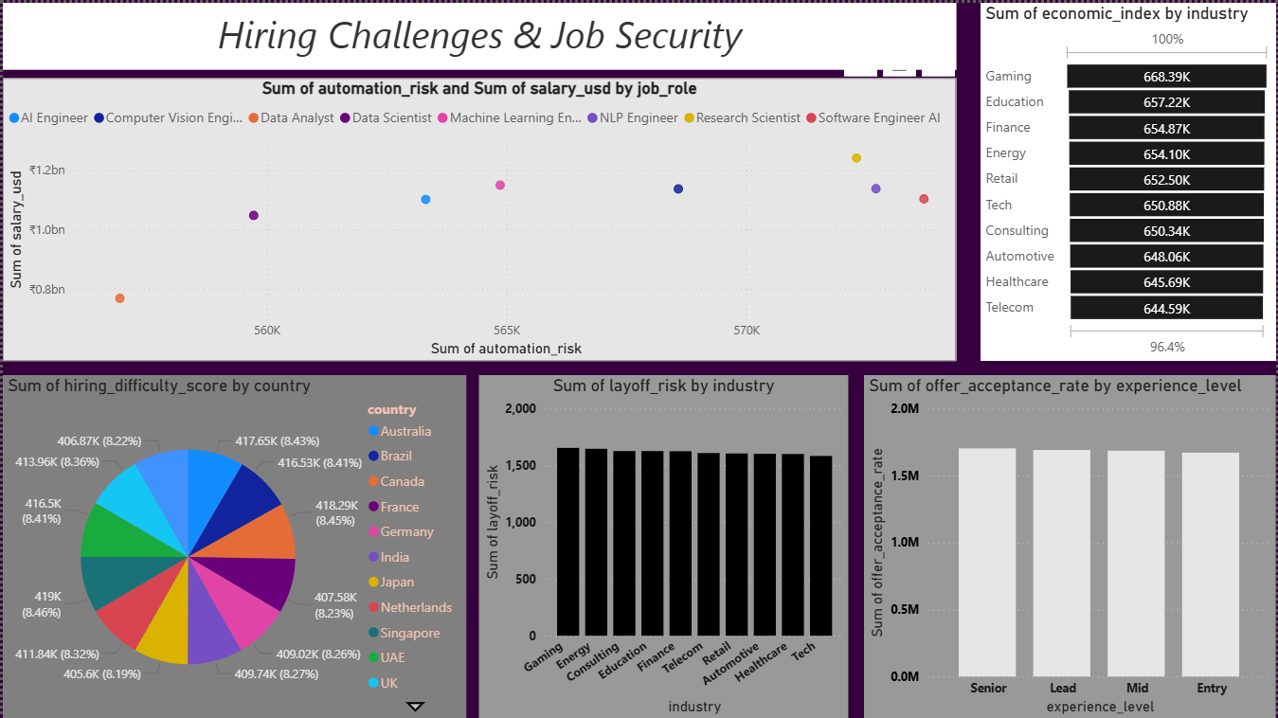

Slide 11
Key Insights
Global demand for AI professionals continues to grow across multiple industries.
Salaries increase significantly with experience level.
Data Scientist and Machine Learning Engineer roles have the highest demand
USA, Canada, and European countries lead global AI hiring.
AI Engineer, Machine Learning Engineer, and Data Scientist are the most in-demand roles.
Emerging technologies like Generative AI, LLMs, and MLOps are shaping the future of AI jobs.
Flexible work modes such as remote and hybrid work are becoming standard in the AI workforce.
Although automation risk exists, most AI-related roles still offer strong job security and career growth opportunities.

Slide 12
Conclusion
AI job opportunities have grown significantly between 2020 and 2026.
Countries such as the USA and Singapore show higher salary levels compared to others.
Senior and Lead roles receive higher salaries and show greater demand.
Remote and hybrid work models are increasingly common in the AI workforce.
Although AI demand is growing, companies still face challenges such as hiring difficulty and automation risk.

Slide 13
THANK YOU

